Slide 1

SlugPath
March 11, 2018
Project Release Plan
Team Slugstras
Team members:
Joven Pableo (Product Owner)
Cameron Skaggs
Pranav Salunke
Srijitha Somangili
Edward John Tagaca (Scrum Master)

Slide 2
SlugPath
Project Release Plan
Living on-campus and ever wonder what the fastest route to get from your dorm/apartment to OPERS? Also how long would it take? Fear not, SlugPath is here to guide you! SlugPath is an online navigation tool for anyone on the UCSC campus that are lost or curious.
High level goal(s):
Be able to represent graph data as a readable file
Be able to organize key locations at UC Santa Cruz
Be able to collect distances and time between two locations
Be able to have a visual representation if user is going the right direction
Be able to find all nearby attractions at one location
Be able to organize product user experience layout
Make the product visually appealing
Create an About page
Community submits additional known paths

Slide 3
SlugPath
Project Release Plan – User Stories
Sprint 1 user stories:
(21 Points) As a javascript developer, I need to develop the shortest path algorithm so that we can display the shortest path on a visualized map.
(13 Points) As a Data Manager, I want node and edge data so that I can organize our data efficiently.
(3 Points) As a User, I want to have a visual representation if I am heading the right direction so that I don't get lost.

Slide 4
SlugPath
Project Release Plan – User Stories
Sprint 2 user stories:
(21 Points) As a data manager, I want to figure out how to represent our data so that our developers can effectively use the data.
(8 Points) As a javascript developer, I need to implement the shortest path algorithm so that we have an array of nodes as the shortest path.
(5 Points) As a developer, I need to sort by nearby attractions so that the users can see nearby attractions.
(1 Point) As a Developer, I need to create an About page so that I can publicize the team.

Slide 5
SlugPath
Project Release Plan – User Stories
Sprint 3 user stories:
(8 Points) As a UX Designer, I need to beautify the website so that users will be attracted to the site and so that the layout is not confusing.
(5 Points) As students, we need to prepare our presentation of our project so that we can get a good final grade.
(5 Points) As a user, I want to have cues to know that I am going in the right direction so that I don’t get lost.

Slide 6
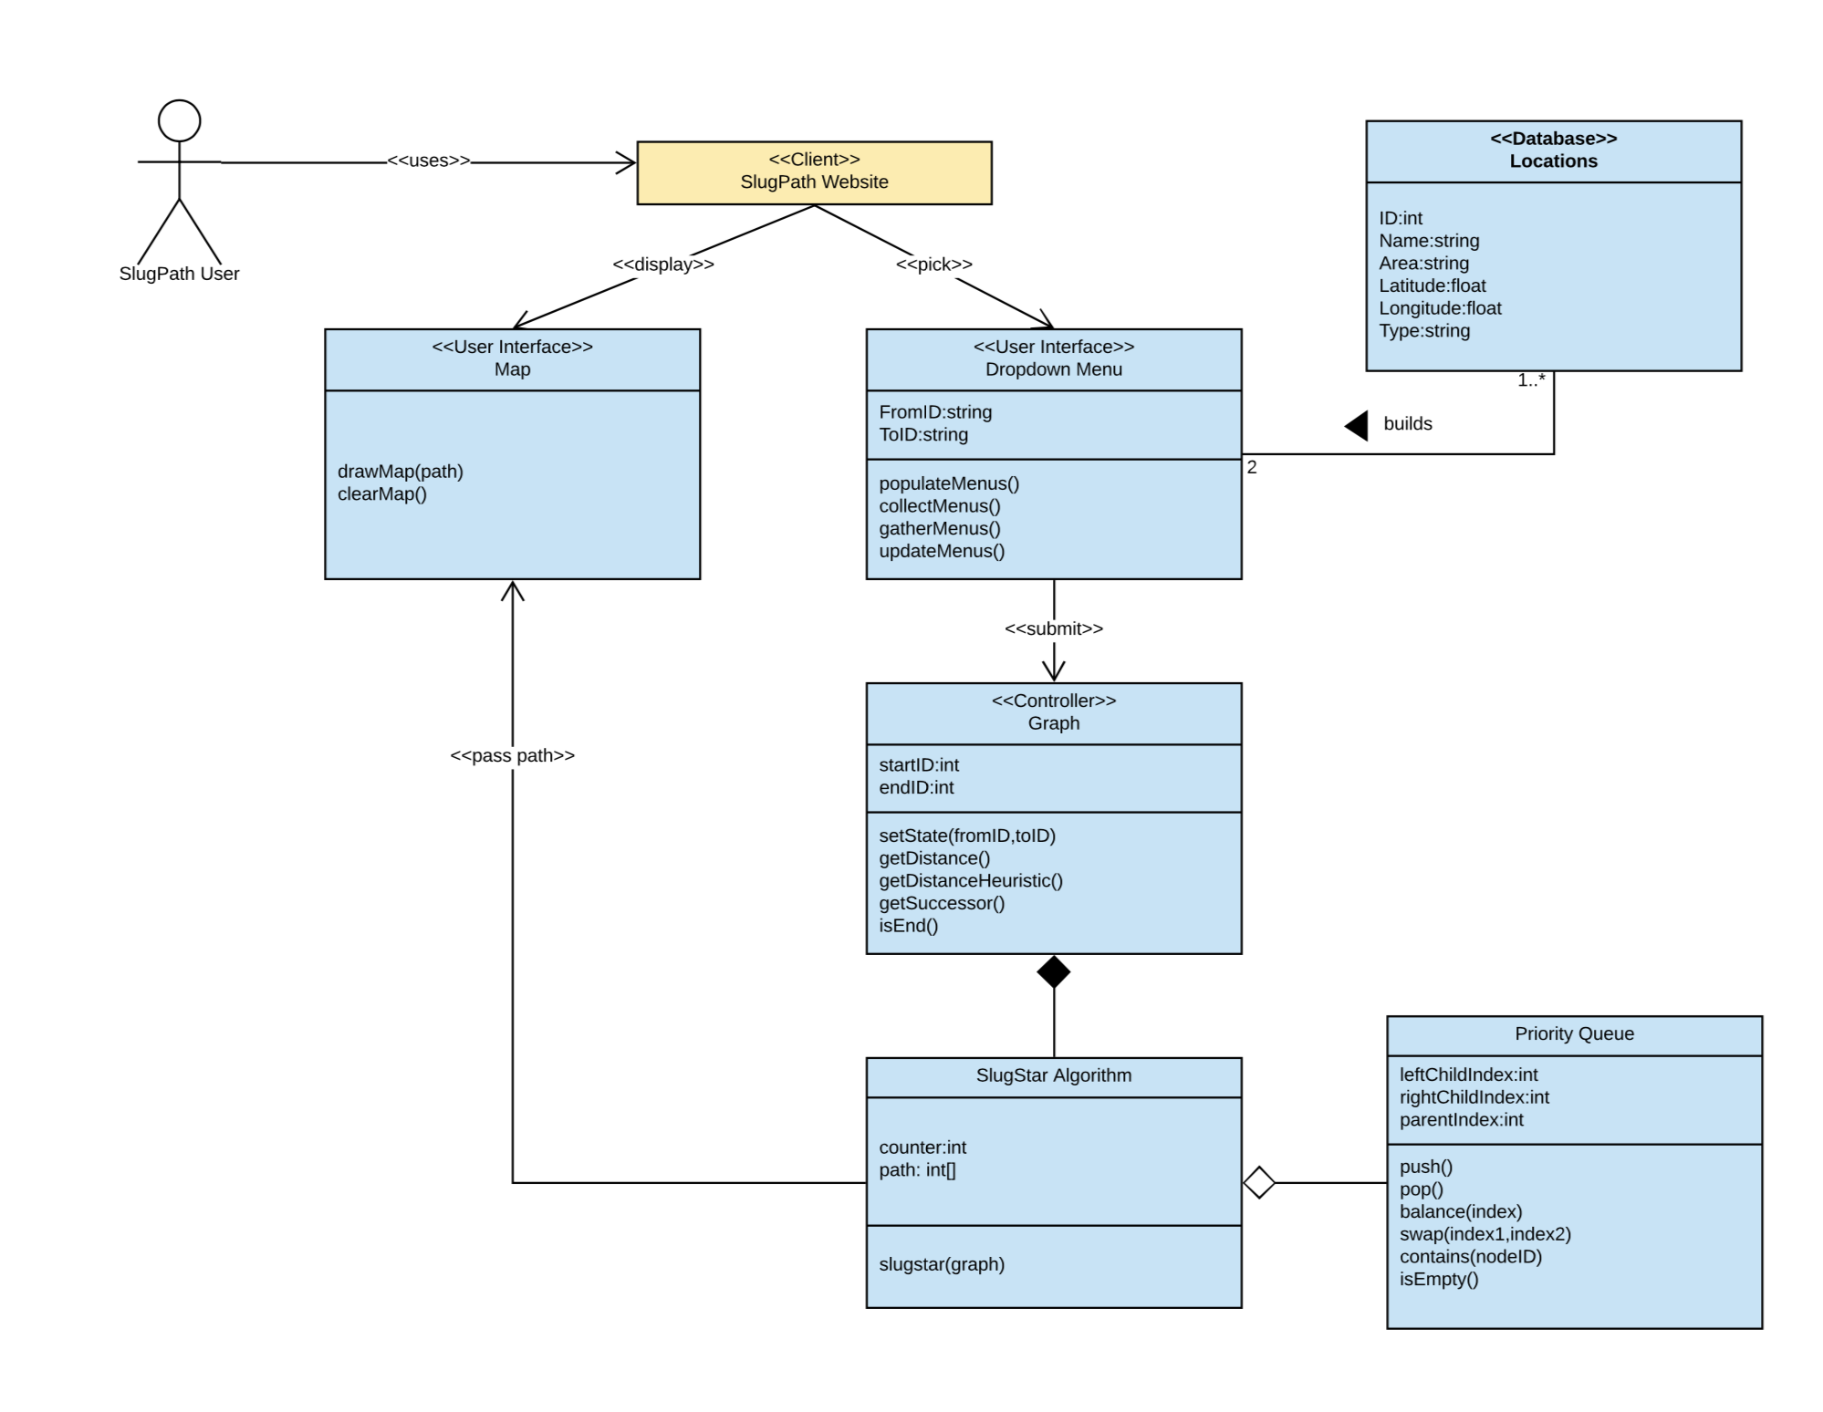
Project Release Plan – Architecture

Slide 7
SlugPath
Project Release Plan – Challenges/Risks
Challenge 1:
Creating a dynamic algorithm so that each user query will not take more than half of a second to load.

Slide 8
SlugPath
Project Release Plan – Challenges/Risks
Challenge 2:
Representing graph data on a readable file for algorithm run on

Slide 9
SlugPath
Project Release Plan – Challenges/Risks
Challenge 3:
Visualizing shortest path on Leaflet which is a new technology for us

Slide 10

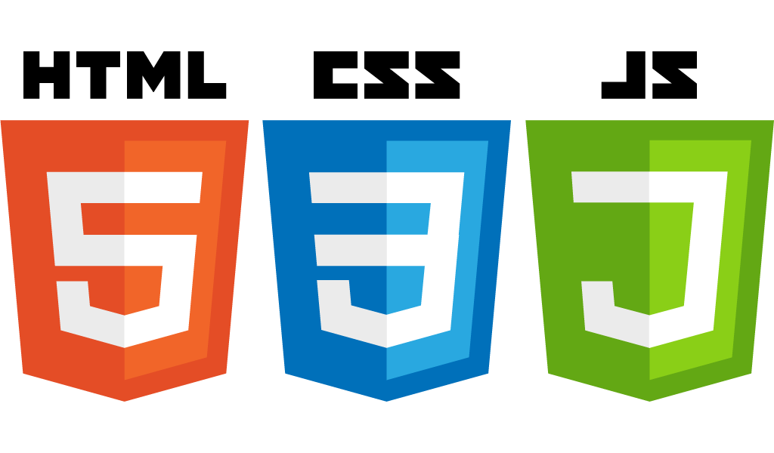
SlugPath
Project Release Plan – Technologies
Technology 1:
HTML
CSS
Javascript
Boostrap

Slide 11
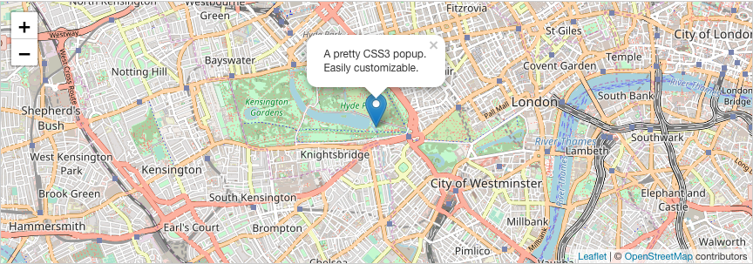
SlugPath
Project Release Plan – Technologies
Technology 2:
Leaflet
Image source via: http://leafletjs.com/

Slide 12

SlugPath
Project Release Plan – Technologies
Technology 3:
Github
Image source via: https://www.pinterest.com/pin/129619295496727517/

